Slide 1
VIRTUAL LEARN ONLINE TRAINING WEBSITE
By
Deepthi Nayak

Slide 2
Virtual Learning or E-learning fulfils the thirst of knowledge and offers online content that can be delivered for the learner at anywhere, anytime and any age through a wide range of e-learning solution while compared with traditional learning system.
It also provides the rapid access to specific knowledge and information.

Slide 3
MODULES
Student Interface
Instructor Interface

Slide 4
STUDENT INTERFACE
In the Student interface, it enables the user to access the online course.
When the user opens the website, it prompts to a login screen and if the user provides valid user name and password the website will open a Dashboard screen.
If the user does not have the account, then the user can register for a new account or if the user forgot the password there is a chance to create a new password using the OTP which is sent to the user’s email account.

Slide 5
INSTRUCTOR INTERFACE
The login or registration procedure follows same as in the student interface
The Instructor interface enables the instructor to manage the course videos, upload quizzes, track student course involvement statistics, and solve students’ doubts regarding the course.

Slide 6
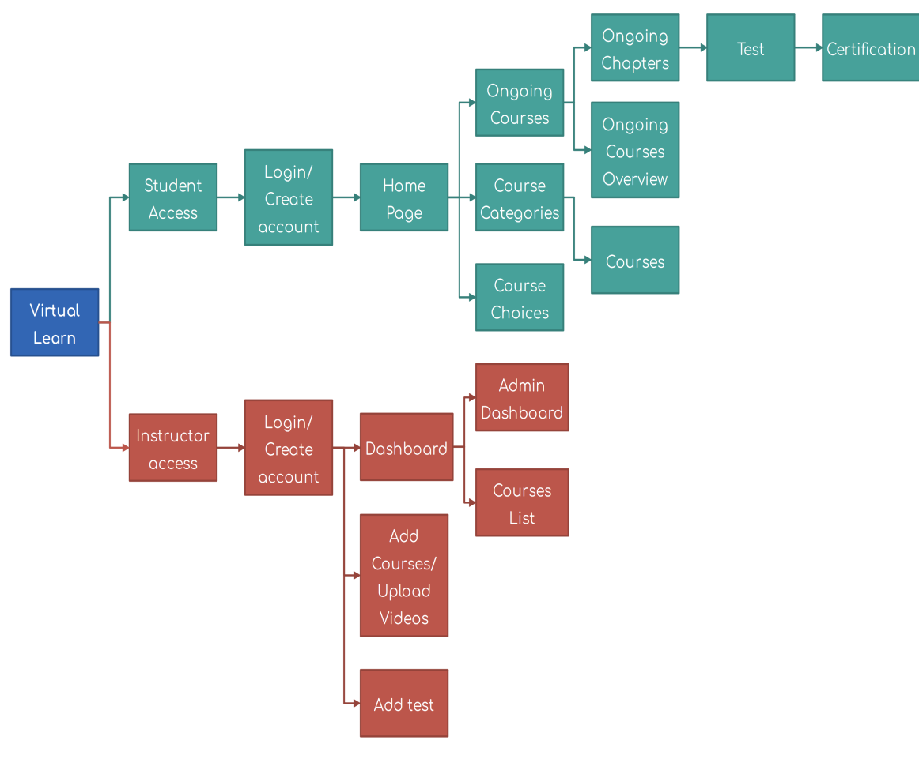

Slide 7
SCOPE OF THE PROJECT
The scope of this project covers the registration of students' personal information
assign tutorial classes to each student
setting a unique password for confidentiality of personal information such as login menu
The limitation of this project is the unavailability of Real-time video chatting.

Slide 8
EXISTING SYSTEM WITH LIMITATIONS
The current system at Zanzibar University is that lectures download references for students or for lecturing.
Students submit assignment to lectures through hard copies or personal emails.
Students only get help from lectures if the lectures are in they’re office.
New lectures to a course have to get materials on their own.
Student are required to physical be in the classroom in order to gain knowledge thereby sacrificing all other responsibilities.
Students are unable to share resources effectively and hold group discussions that are monitored or supervised by lectures

Slide 9
FUTURE ENHANCEMENT
Lectures to upload assignments and resources for their units.
Students to download the resources and upload assignments.
It provides an easy-to-use way to manage course websites that include schedule information, announcements, as well as course discussions.

